Slide 1
Enforce MFA for External Application Access
M365 – MS 100
Notes:
Importance planning

Slide 2
Topics
Introduction to Conditional Access
Demo: How to Enforce MFA for application access.
Notes:
Picture

Slide 3
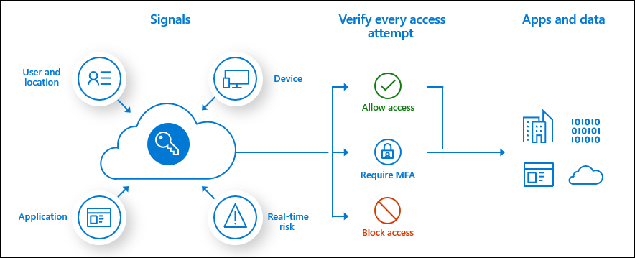
Conditional Access
More control on Users login based on Realtime signals

Slide 4
Next Video
MFA with conditional access for External users
Summary
Summary

